Slide 1
Adolf Hitler

Slide 2
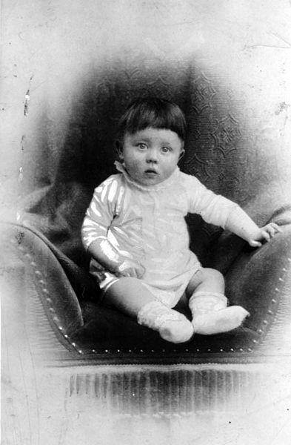
Adolf Hitler as a child.

Slide 3
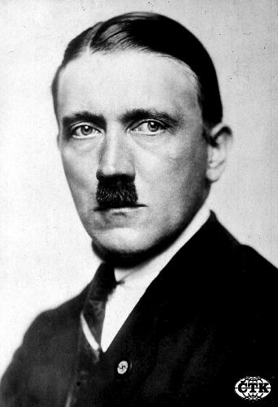
Adolf Hitler in the WW I

Slide 4
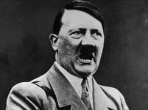
Adolf Hitler in WW II

Slide 5
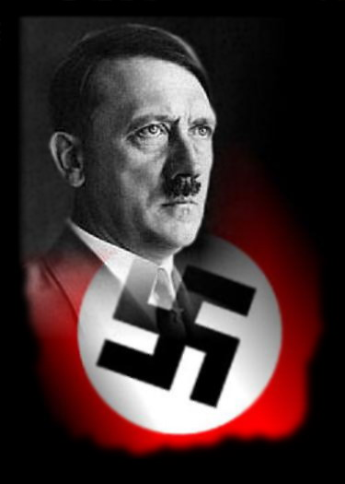
characters
characters

Slide 6
Hitler´s sign

Slide 7
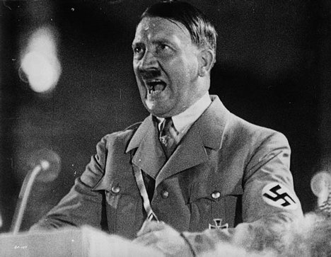
Hitler speaks to people

Slide 8
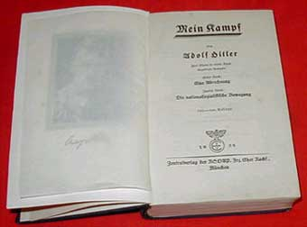
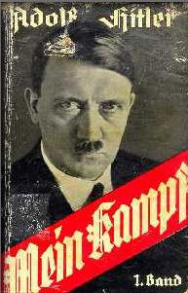
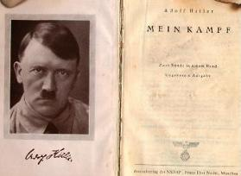
Mein Kampf - Hitler‘s book

Slide 9
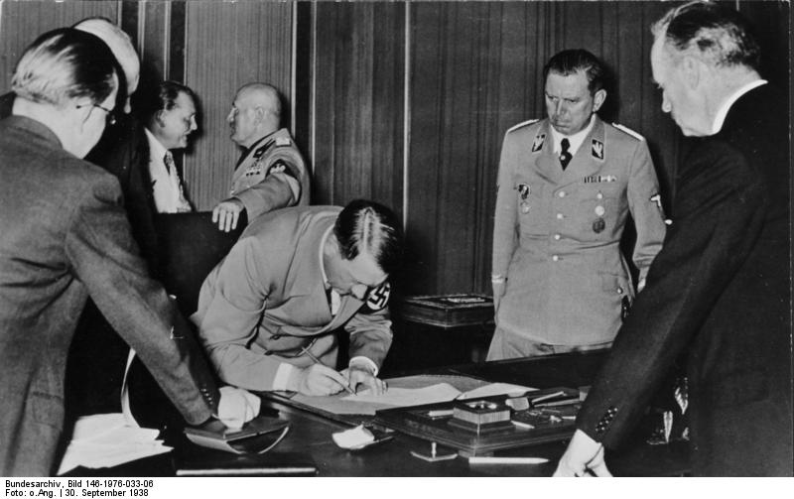
Adolf Hitler signed Munich diktat

Slide 10
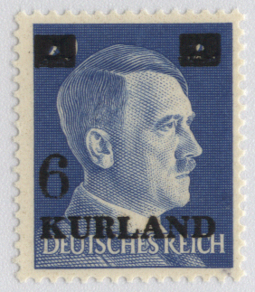
Postage stamp with Hitler

Slide 11
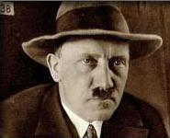
Hitler committed suicide on 30.4.1945

Slide 12
This presentation was made by Pavel Hrůza

